Slide 1




BTP PRESENTATION
5TH SEM
TITLE - TRAFFIC VIOLATION MONITORING AND SAFETY ENFORCEMENT PROJECT
Saurabh Gawali

Slide 2
INTRODUCTION
Aim of the project
Encourage people to wear helmets for safety.
Automatically detect helmets using ML.
Penalise rule breakers.
Statistics
Approximately 1.3 million people die each year as a result of road traffic crashes. link
Correct helmet use can lead to a 42% reduction in the risk of fatal injuries and a 69% reduction in the risk of head injuries. link

Slide 3
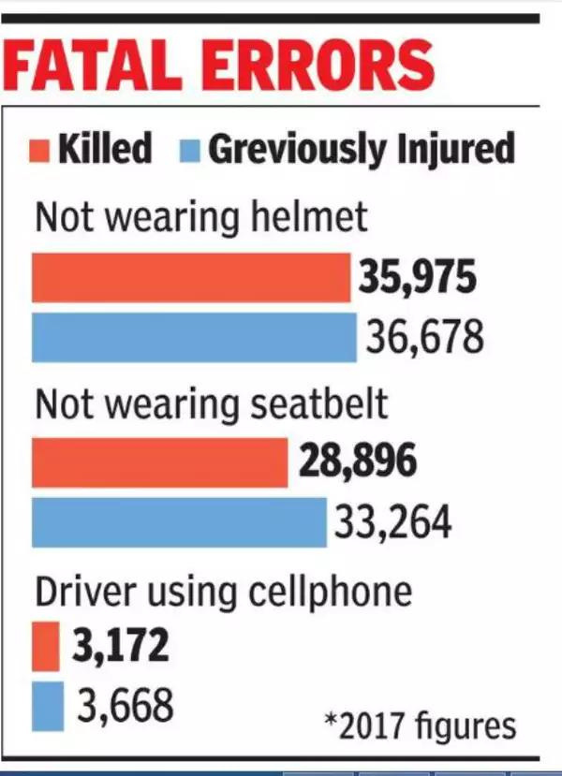
INTRODUCTION
Statistics
46,593 persons who were not wearing helmets were killed in road accidents in the year 2021 in India. link
73.8% of motorcyclists who died did not wear a helmet in 2017. link

Slide 4



PROBLEM STATEMENT
Make a ML model to detect helmet and the biker’s number plate through a live video stream.
Keep track of the user’s diligence with the help of social score.
Low social score leads to high amounts of fines and expensive vehicle insurance.

Slide 5
LITERATURE REVIEW
S. No. | Author Name/ Publication | Year | Methodology | Remark | Accuracy
1. | [4] Surinder Kaur, Aman Jain, Jatin Gupta, and Somya Khandelwal | 2021 | YOLO v5s for LP detection | YOLO v5s can detect LP in images. YOLO v5 will be needed to detect LP from video streams. | 1) Mean Accuracy Precision -> 98.4% 2) Precision Parameter -> 95.3% 3) Recall -> 98.8 % accurate
2. | [6](ICT Express) Yonten Jamtshoa,∗ , Panomkhawn Riyamongkolb , Rattapoom Waranusastb | 2021 | YOLO v2 algorithm for helmet detection and LP detection | This model successfully detects the helmet and its corresponding number plate for a single vehicle. | The helmet detection rate of the proposed method is 94.54% (F1-score)
3. | [3] (IJIRST) Yash Gujarath, Avyashree Devadiga, Pratik Khanapurkar, Shreya Joshi | 2018 | CNN for helmet and LP detection | It doesn't provide performance metrics or comparisons to existing methods, making it difficult to assess the system's effectiveness. | ----

Slide 6
LITERATURE REVIEW
S. No. | Author Name/ Publication | Year | Methodology | Remark | Accuracy
4. | [1](ieee) Rattapoom Waranusast, Nannaphat Bundon, Vasan Timtong, Chainarong Tangnoi, Pattanawadee Pattanathaburt. | 2017 | KNN Algorithm, Background subtraction for Helmet detection | The disadvantage of this method is that in case of 2 bikes overlapping, the algorithm considers it as one and doesn’t detect 2 separate riders. | 1) Bike recognition -> 95% accurate 2) Head detection -> 83.82% accurate 3) Helmet detection -> 89% accurate and 74% for both lane
5. | N.I. Glumov, E.I. Kolomiyetz, V.V. Sergeyev | 2017 | Sliding Window Technique for object detection | Model trained by Sliding Window Algorithm is unable to decide fixed sized for sliding window, so sometime probability or accuracy of detecting object may decrease. | --

Slide 7

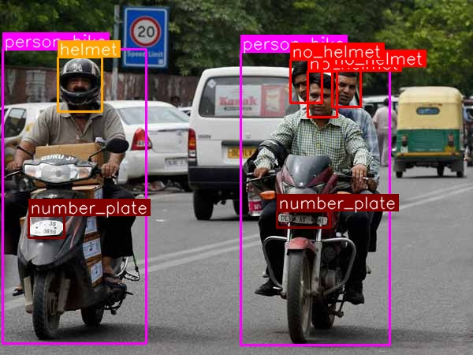
PROPOSED METHODOLOGY
ML Model for helmet detection and Licence plate number detection
Management of Social Score

Slide 8
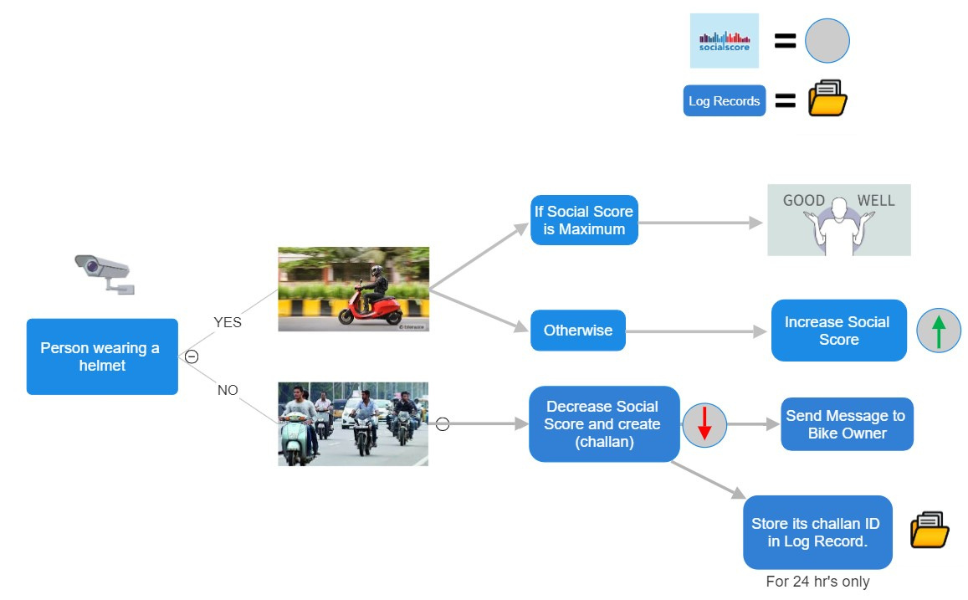
MANAGEMENT OF SOCIAL SCORE

Slide 9
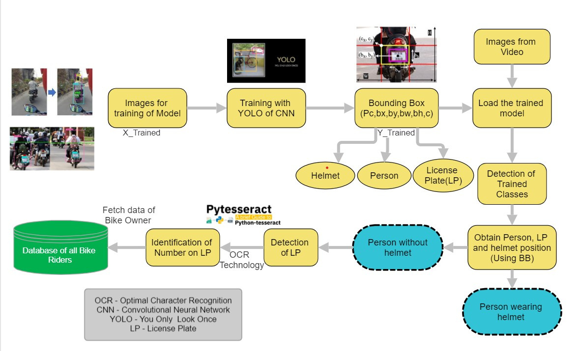
ML MODEL

Slide 10
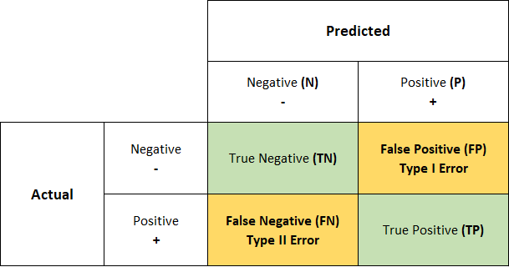
EXPECTED OUTCOMES
Using the YOLO CNN algorithm, our model will predict whether a person is wearing a helmet or not.
Decrease a person’s Social Score by detecting his Licence Plate if he is not wearing a helmet.
Following table shows the confusion matrix for the model.

Slide 11
CONCLUSION
Reduce routine tasks of traffic police
Automated systems are more accurate and consistent than humans.
Penalising again and again and difficulty in getting insurance will further force the rider to wear a helmet.
If the government likes the idea of Social Score then it can use the idea in different sectors like banking, police verification for passports etc.

Slide 12
REFERENCES
[1] Rattapoom Waranusast; Nannaphat Bundon; Vasan Timtong; Chainarong Tangnoi; Pattanawadee Pattanathaburt 2013 28th International Conference on Image and Vision Computing New Zealand (IVCNZ 2013), DOI: 10.1109/IVCNZ.2013.6726989
[2] Shan Du; Mahmoud Ibrahim; Mohamed Shehata; Wael Badawy, IEEE Transactions on Circuits and Systems for Video Technology ( Volume: 23, Issue: 2, February 2013), DOI: 10.1109/TCSVT.2012.2203741
[3] Yash Gujarath, Avyashree Devadiga, Pratik Khanapurkar, Shreya Joshi IJIRST –International Journal for Innovative Research in Science & Technology| Volume 4 | Issue 11 | April 2018 ISSN (online): 2349-6010
[4] Surinder Kaur, Surinder Kaur, Aman Jain, Jatin Gupta, and Somya Khandelwal June 2021 DOI:10.5281/zenodo.5171216.
[5] A PUBLIC HEALTH PERSPECTIVE OF ROAD TRAFFIC ACCIDENTS, 2019HTTPS://WWW.NCBI.NLM.NIH.GOV/PMC/ARTICLES/PMC3893966/ (ACCESSED NOV. 17, 2019).
[6] Yonten Jamtshoa,∗ , Panomkhawn Riyamongkolb , Rattapoom Waranusastb a Gyalpozhing College of Information Technology, Gyalpozhing 43002, Bhutan b Naresuan University, Phitsanulok 65000, Thailand
ICT Express Volume 7, Issue 1, March 2021, Pages 104-109

Slide 13
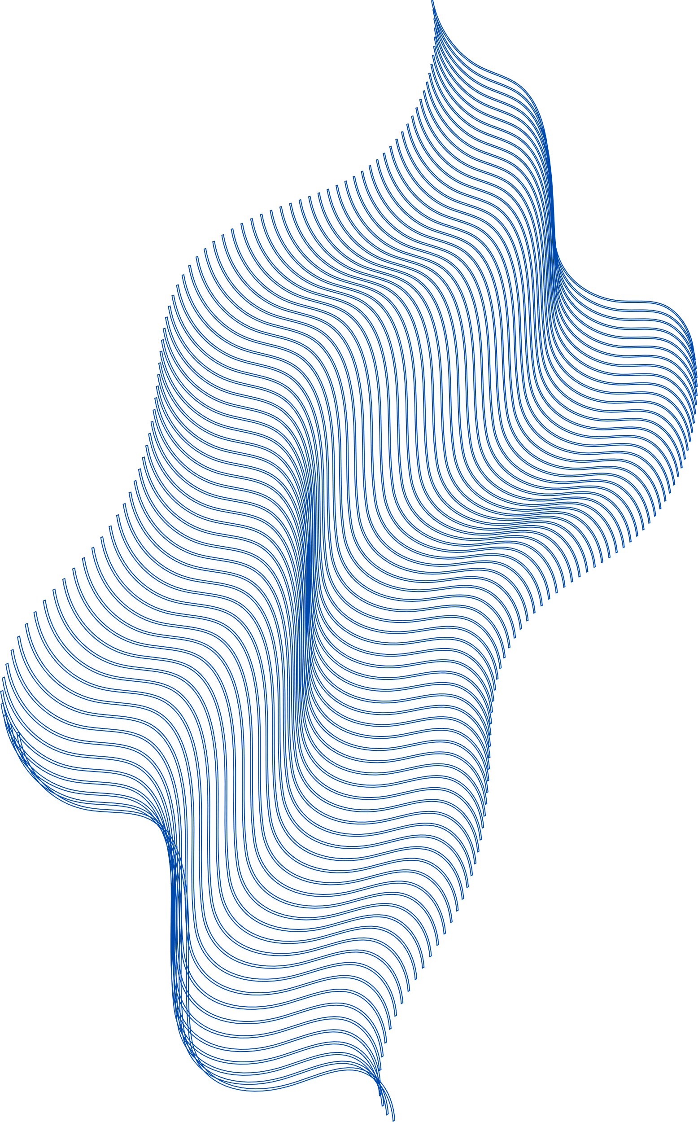
THANK YOU!

